Slide 1
Portable Weather Station with Web based Data Visualisation and Analytics
TEAMMATES:
SHEELAVANT N SAI KRISHNA – 18BEC0905
G V GANESH MAURYA – 18BEC0128
GYAN VALLABH K – 18BEC0899
NAKKA PAVAN KALYAN – 18BEC0847
IoT Fundamentals ECE3501
J - Component
Review - 3

Slide 2
Introduction
• Make a compact and reliable weather monitoring package for a user to know about his/her location’s weather conditions or check the precise conditions at his/her home when the user is away.
• Provide personalized periodic notifications to the user’s primary device about the conditions of a particular day and suggest short notes for the user to handle the day.
• Provide the user with a dashboard which contains a comprehensive view of the weather and climate of the day, so the user can plan his errands accordingly.

Slide 3
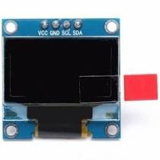
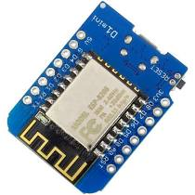
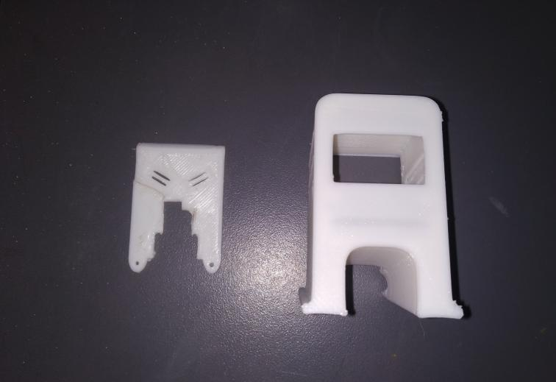
Components and Software used
Hardware
1. Wemos D1 Mini
2. 1.3 Inch I2C/IIC Display Module
3. 3D Printed case
Software
1. Arduino IDE 6. ThingPulse
2. Node RED
3. IFTTT
4. Initial State
5. OpenWeather Map API

Slide 4
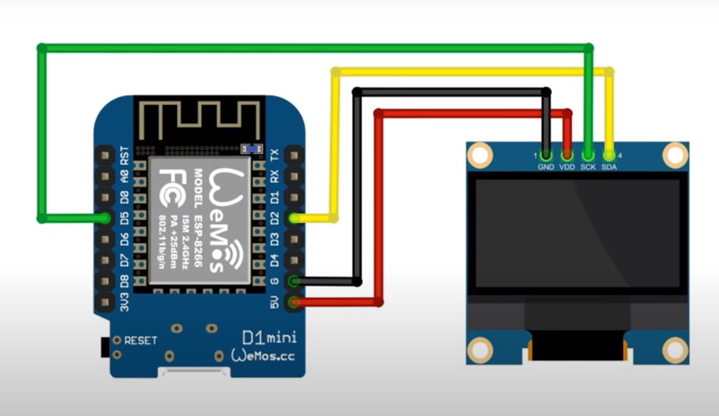
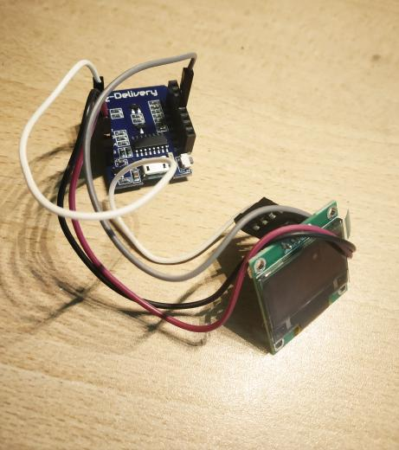
Circuit Diagram

Slide 5
Working
Raw weather data that consists of important climate parameters are obtained by the Wemos D1 Mini board through the API linkage provided by the Weather Station library by ThingPulse (Arduino IDE).
The Weather Dashboard created though the InitialState platform then obtains the same information from a related API which (WeatherStack API).
Certain parameters are then injected into Node-RED which in turn pushes values as information to IFTTT that interfaces the mobile devices to Node-RED for pushing notifications to the user’s phone.
We are using Node-Red as the main connector of mobile, hardware device and the website (Initial State).
Through Node-Red we are sending the current time using timestamp to Initial State.
We are also sending the data that is read by Wemos Mini to Initial State using Node-Red.
Mobile phone notifications are sent through Node-Red using IFTTT every 2-3 hours. These notifications contain the temperature and a short description. When we click on the notification it takes us to Initial State webpage where we can get better understanding more information.

Slide 6
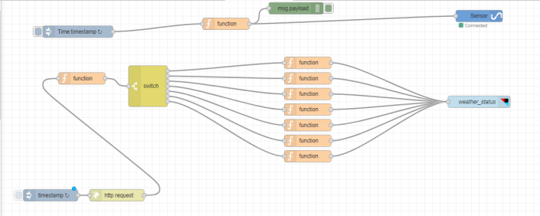
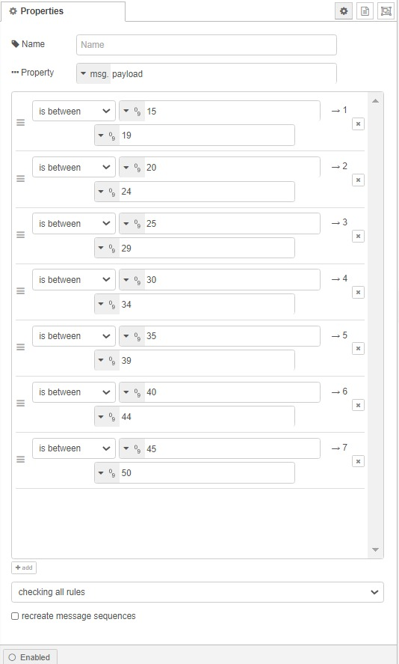
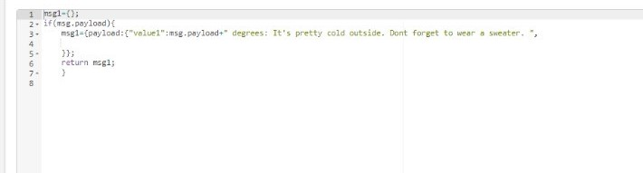

Slide 7
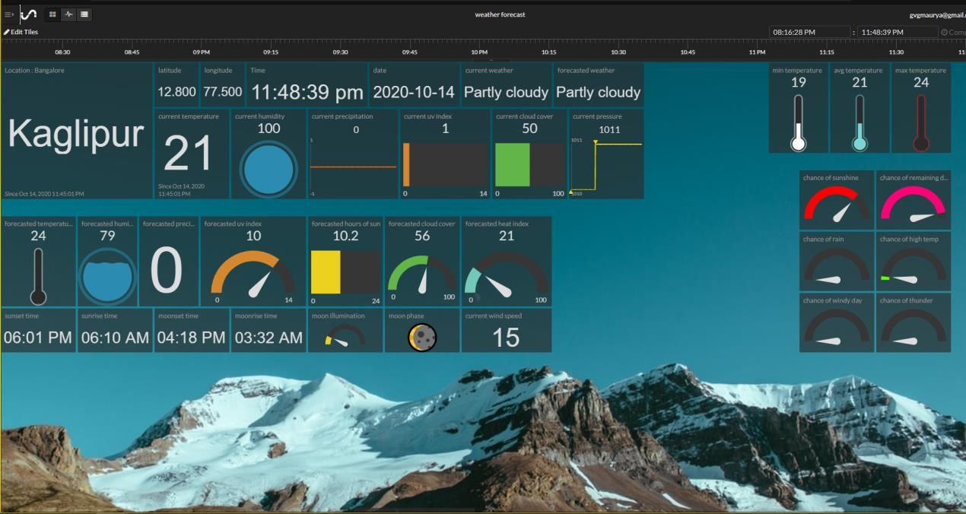
Initial State Output:

Slide 8
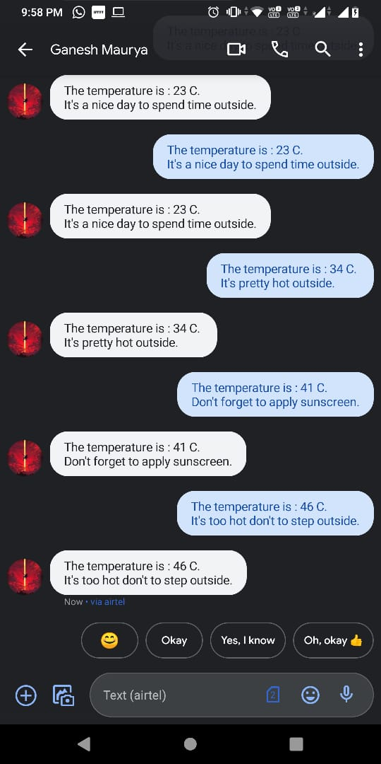
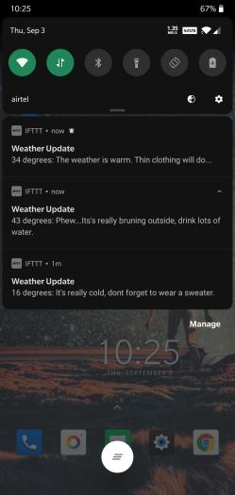
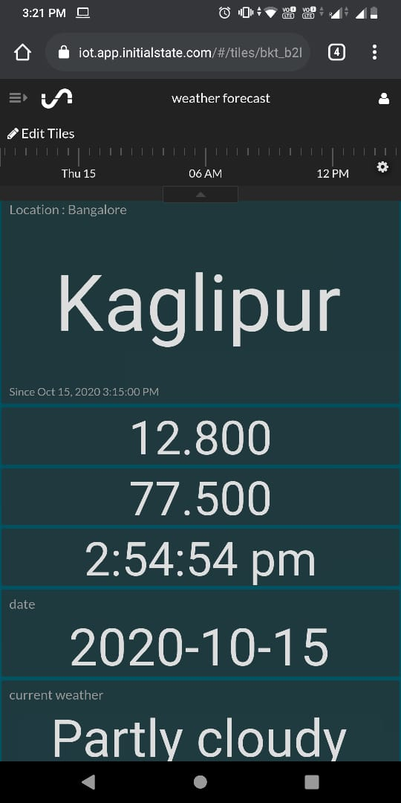
Output on the phone

Slide 9
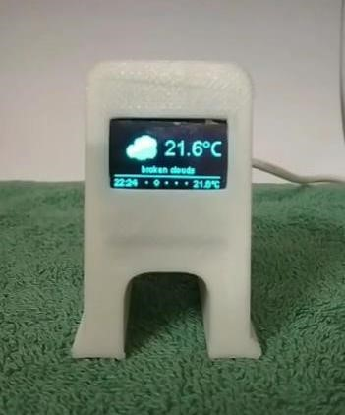
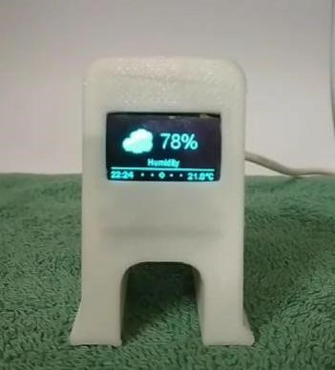
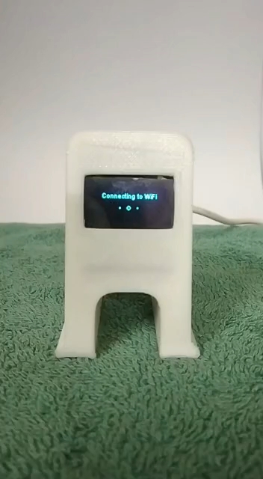
Hardware Output

Slide 10
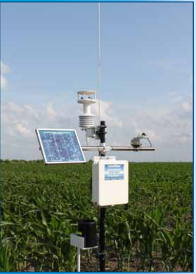
Improvements
The compact size of a handheld weather device is another advantage. Being so small in size, the meter is easy to carry and without any compromise on quality and functionality. Instead of lugging heavy equipment around, the device is pulled out of a pocket or backpack and attached to a smartphone.
With a limited intervals of time we have update alias we would have full control over the weather.
Main Aims of this project:
Agriculture is basic real life motto of our project.
Self driving car is basic tech improvement which can be done

Slide 11
Thank You

